Slide 1
Cloud Computing
Dr. Md. Nasim Adnan

Slide 2
Virtualization
When you use cloud computing, you are accessing pooled resources using a technique called virtualization. Virtualization assigns a logical name for a physical resource and then provides a pointer to that physical resource when a request is made.
Virtualization provides a means to manage resources efficiently because the mapping of virtual resources to physical resources can be both dynamic and facile.
Virtualization is dynamic in that the mapping can be assigned based on rapidly changing conditions, and it is facile because changes to a mapping assignment can be nearly instantaneous.

Slide 3
The following mapping patterns are used:
P2V: Physical to Virtual
V2V: Virtual to Virtual
V2P: Virtual to Physical
P2P: Physical to Physical
D2C: Datacenter to Cloud
C2C: Cloud to Cloud
C2D: Cloud to Datacenter
D2D: Datacenter to Datacenter

Slide 4
Load Balancing and Virtualization
?
?

Slide 5
Load Balancing
Load balancing is an optimization technique; it can be used to increase utilization and throughput, lower latency, reduce response time, and avoid system overload.
Without load balancing, cloud computing would be very difficult to manage. Load balancing provides the necessary redundancy to make an intrinsically unreliable system reliable through managed redirection. It also provides fault tolerance when coupled with a failover mechanism.

Slide 6
In the simplest load-balancing mechanisms, the load balancer listens to a network port for service requests.
When a request from a client or service arrives, the load balancer uses a scheduling algorithm to assign where the request to be sent.
Typical scheduling algorithms in use today are round robin and weighted round robin, fastest response time, least connections and weighted least connections, and custom assignments based on other factors.

Slide 7
A session ticket is created by the load balancer so that subsequent related traffic from the client that is part of that session can be properly routed to similar resource.
Without this session record, a load balancer would not be able to correctly failover a request from one resource to another.
More sophisticated load balancers are Workload Managers. They determine the current utilization of the resources in their pool, response time, work queue length, connection latency and capacity, and other factors in order to assign tasks to each resource.

Slide 8
Virtualization
Given a computer system with a certain set of resources, you can set aside portions of those resources to create certain number of virtual machines. From the standpoint of applications or users, a virtual machine has all the attributes and characteristics of a physical system but is strictly software that emulates a physical machine.
A low-level program is required to provide system resource access to virtual machines, and this program is referred to as the hypervisor or Virtual Machine Monitor (VMM).
A hypervisor running on bare metal is a Type 1 VM or Native VM. Examples of Type 1 Virtual Machine Monitors are LynxSecure, RTS Hypervisor, Oracle VM, Sun xVM Server, VirtualLogix VLX, VMware ESX and ESXi, and Wind River VxWorks, among others.

Slide 9
The operating system loaded into a virtual machine is referred to as the guest operating system, and there is no constraint on running the same guest on multiple VMs on a physical system.
Type 1 VMs have no host operating system because they are installed on a bare metal.
An operating system running on a Type 1 VM is in full virtualization because it is a complete simulation of the hardware that it is running on.

Slide 10
Some hypervisors are installed over an operating system and are referred to as Type 2 or hosted VM.
Examples of Type 2 Virtual Machine Monitors are Containers, KVM, Microsoft Hyper V, Parallels Desktop for Mac, Wind River Simics, VMWare Fusion, Virtual Server 2005 R2, Xen, Windows Virtual PC, and VMware Workstation 6.0 and Server, among others.
This is a very rich product category. Type 2 virtual machines are installed over a host operating system; for Microsoft Hyper-V, that operating system would be Windows Server.

Slide 11
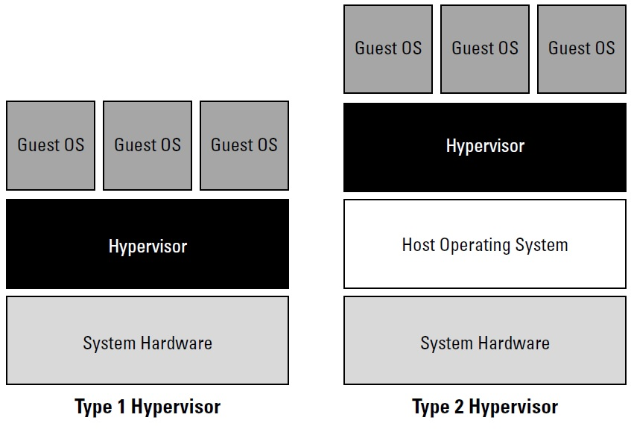

Slide 12
On a Type 2 VM, I/O operations are placed outside the virtual environment, which makes it both programmatically easier and more efficient to execute I/O operations.
This type of virtualization is sometimes referred to as paravirtualization, and it is found in hypervisors such as Microsoft’s Hyper-V and Xen. It is the host operating system that is performing the I/O through a para-API.

Slide 13
An operating system running as a guest on a paravirtualized system must be able to work with the para-API.
On the other hand, all operating systems in full virtualization communicate directly with the hypervisor, so guest operating systems do not require any constraint.
Guest operating systems in full virtualization systems are generally faster than other virtualization schemes.

Slide 14
Applications running inside an operating system of Type 2 VM are generally slow, but this scheme is very popular as it provides portability (through images), can access many advanced features from the host operating system (through para-APIs), allow resource independence and arrange own security schemes for the guest operating system and for the applications as well.

Slide 15


